Slide 1
Rules from the lab
Teams
Pay
Talent Development

Slide 2
Teams
Teams are interdependent, bounded, share a goal, have authority to manage their work.
Modal team size is 11.92 (optimal is around 5-6)
Most common team type is self-managing (52%) followed by manager led (42%) and self-directing (6%).
Most common team problems are coordination, minimizing confusion, and motivation.
On average, teams stay in place for 1-2 years.
Notes:
Key Point: Getting from the general to the specific is one of the key challenges managers face when using evidence based research (academic findings) to guide your actions. However, used wisely, this is the way to go (it will increase your chances of success in comparison with going off your hunches).

Slide 3
Team Design
If asked why a team failed, most managers cite external factors (the economy) or difficult personalities.
However research shows that neither of these is usually the problem.
Managers can design high functioning teams using evidence based principles.
A sampler…
Authority
Decisions
Creativity
Notes:
Key point: to diagnose team problems, first avoid the temptation to blame the people; look instead at the design of the team, the work flow, the processes, the skills, the communication patterns.

Slide 4
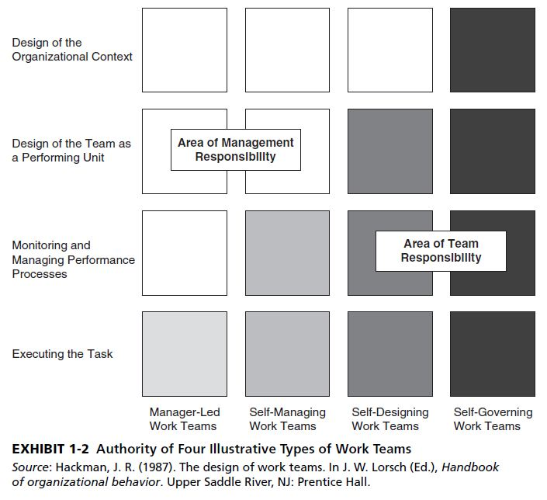
Types of teams in organizations
Notes:
Key Point: This is our first useful evidence based advice: As you increase a team’s authority, the team will have more potential for innovation and also time-consuming conflict.

Slide 5
For important decisions who does better: teams or individuals?
Demonstrable task
Defined as: a task that has an obvious, correct answer
Groups perform better than independent individuals on a wide rage of demonstrable tasks
In general, group performance increases over that of individuals as the demonstrability of the task increases
Group to individual transfer is a phenomenon where individual group members become more accurate during group interaction
Notes:
Key Point: the belief that a high functioning team brings different perspectives, can be more critical of options, and therefore can make better decisions than one expert, is only partially true.
Key Point: the mechanism underlying success in demonstrable tasks seems to be a sharpening of the accuracy of group members in the presence of others. “Team member A: Should we target Omaha? It has a population of 1M?”…”Team Member B: Sure, but of those 1M, 70% cannot afford our product.”

Slide 6
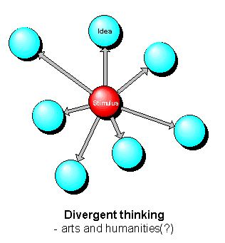
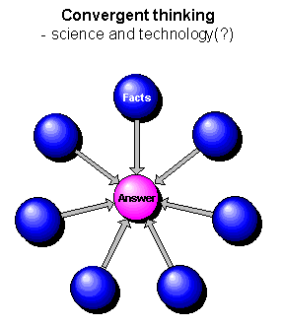
Convergent and Divergent Thinking
Notes:
Key Points: Teams tend to excel at convergent thinking and individuals at divergent thinking. Convergent thinking is analogous to a “demonstrable task.” In contrast, convergent thinking…”What are new and novel ways we could approach marketing?” – there is no right answer.

Slide 7
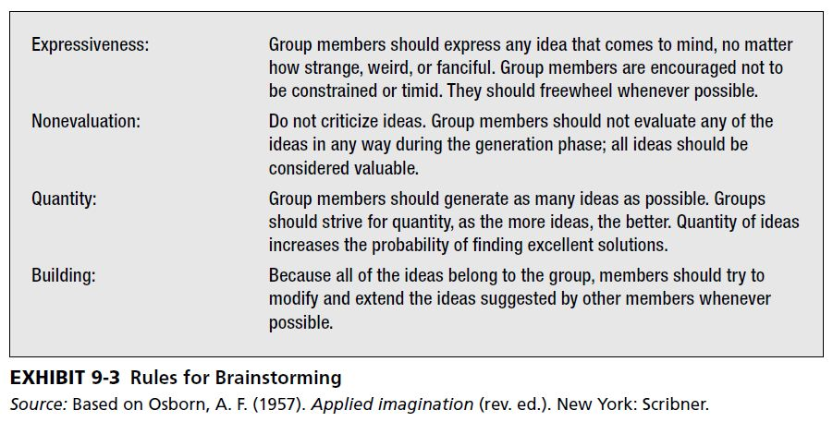
Creative people or creative teams?
Osborne’s Rules of Brainstorming
Exhibit 9-3
Notes:
Key Point: Brainstorming was first described and used widely in the 1950’s using a very sensible set of rules articulated by Osborn. You can see that they are likely to create an environment for innovation.

Slide 8
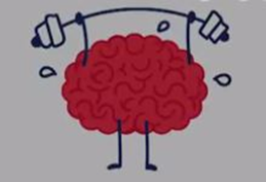
Visualize the experiment
Notes:
Key Point: the same amount of people (in this case four) were place either together (right side) or they were separated physically (left side). They were then asked to generate ideas in a specific timeframe.
Most experiments measured quantity and quality.

Slide 9
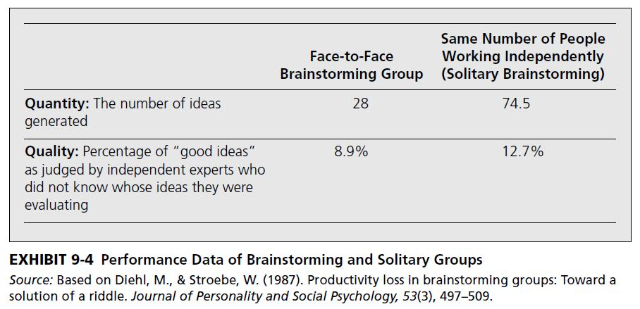
Creative people or creative teams?
Whoops!
Notes:
Key Point: People working independently perform better than brainstorming groups. This effect has been replicated in thousands of experiments. The data indicates that Osborne is probably wrong.

Slide 10
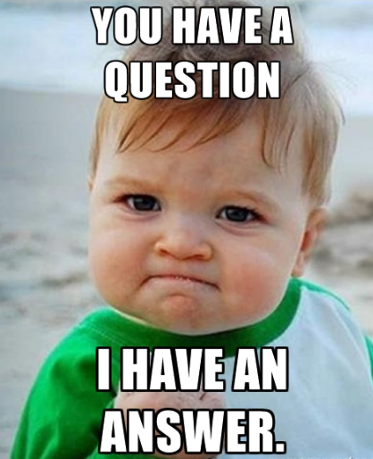
Everyone? Blair and Jill?

Slide 11
Pay: a long story…
Notes:
Be careful what you wish for

Slide 12
Let’s create a baseline for a good pay system
Notes:
Key Point: it is obvious that we need to develop fair pay systems. This means
that people get paid for their skills and experience when they apply it to the job
that they are paid fairly compared to people doing similar work in the same company
that they are paid fairly compared to people doing similar work at other companies.

Slide 13
Pay for creativity?
But if you want more … you want employees to be creative, innovative…
This creativity is not defined by anything in their job description – it happens when employees feel they can experiment outside of regular job duties. It is unexpected.
Examples – Frappuccino
One solution is to provide pay-for-performance (PFP) – merit increases, a bonus, and so on.

Slide 14
Deci and Amabile versus Eisenberger The great pay food fight.
Two concepts: intrinsic and extrinsic motivation.
Autonomy & intrinsic motivation
Deci and Amabile
Paying people extra to do work they love diminishes their motivation. In a word, having work “fun” is now a J. O. B.
This lab result was repeated many times.
Notes:
Key Point: Early research showed that paying (providing extrinsic rewards) people for creative work tends to make them like the work less and they do less of it.

Slide 15
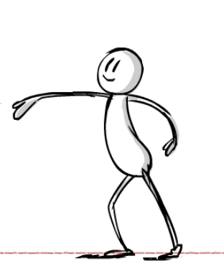
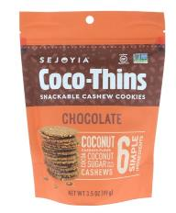
The great pay food fight.
Eisenberger
Get out of the lab and see what is going on! That is not what is happening in the workplace. Extrinsic rewards rule!

Slide 16
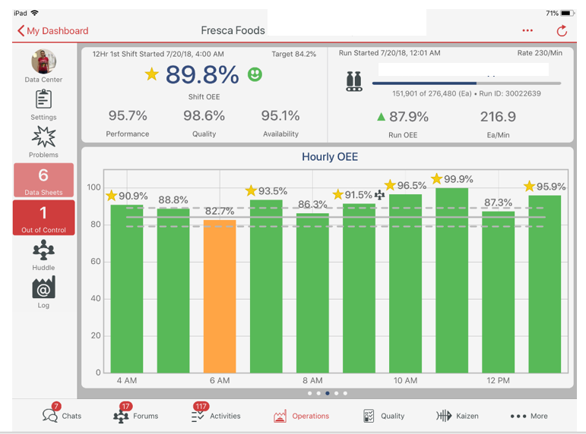
Principle #1
Extrinsic rewards do work very well for repetitive and routine work.
Example – gainsharing
Principle #2
Rewards for creative work are effective when they “inform” employees what behavior is valued. Informing effect.
Notes:
This first point has been repeated again and again. So yes, go forward with no concerns.
The second point is that rewards PCP performance contingent pay do help tell people what to do more of.
This is nothing new.

Slide 17
Nuances
Principle #3
Rewards can work if they are small enough.
Controlling effect: rewards can be a problem when they “narrow” the focus of the employee.
Example: A consultant has a goal of 2000 billable hours to client and a large bonus. She is less likely to spend slack time creating new ideas for consulting services.
Solution: give a small reward. Merit pay … yes….gainsharing.
Principle #4
Rewards can work if they are general enough.
Specificity: rewards are more effective when the goal is non-specific versus specific.
Specific goals narrow attention to what must be produced.
Example: your goal is to get a certain rating from a client. You will not experiment with new consulting techniques – you will stick with what works.
Solution: don’t use SMART goals. 20% time?
Notes:
Key: Creative work is novel and practical. It is generally produced out of the bounds of normal duties when an employee is motivated to produce it. Under certain conditions, rewards for creative work can be useful. Here are three:
When the reward doesn’t control (it is small – it is an acknowledgment). It does not limit autonomy or feel controlling.
If the goal given is not overly specific: hit a monetary target, recruit five new people by January.

Slide 18
10 years later…truce
Agreement – and Principle #5
Large rewards can work if they are unanticipated.
If anticipated (“if I do this, I get this”) the employee feels controlled by the reward.
If unanticipated, the employee feels they can “play,” in effect.
Solution: make the prize a surprise!
Notes:
Key Point: With pay and motivation, one size does not fit all.

Slide 19
Talent Festival
Notes:
Key: In this section we think about what it takes to develop individual skills. Our culture puts a great emphasis on individuals and their special talents. Talent is seen as necessary for greatness. The research says otherwise, it suggests that expertise development is largely in our control.

Slide 20
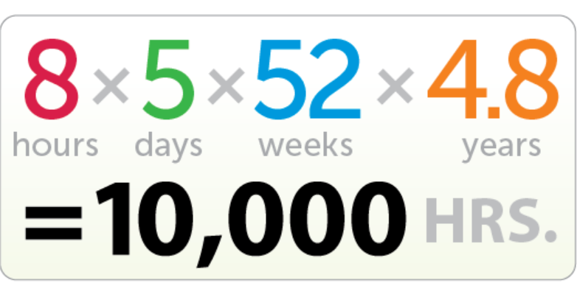
Fabled 10,000 rule
Notes:
Key: This is a much overused and much misunderstood number. It does reflect a reality: it takes a long time to be an expert.

Slide 21
Music Academy of West Berlin
3,420
5301
7410
Notes:
Key: Erickson and others investigated how experts become expert. This is where the 10,000 rule came from. But there was far more to it.

Slide 22
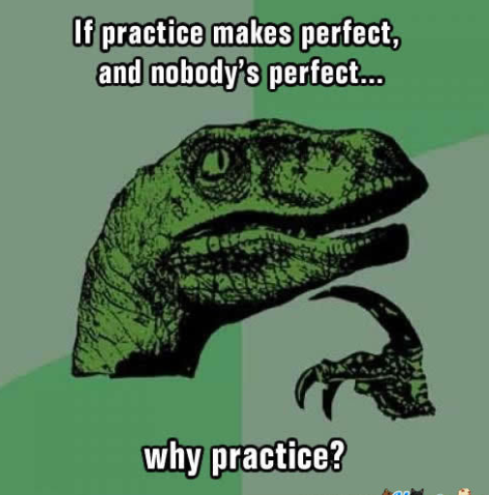
Deliberate Practice
Specifically designed to improve performance.
Usually involves a teacher.
Feedback is always available.
Highly mentally demanding.
(“grin and bear it” type of activity)
Notes:
Key: very specific practices lead to expertise. The time spent is wasted unless you engage in these practices.
Key: don’t wait for your manager to do this for you.

Slide 23
Everyone? Blair and Jill?

